Slide 1
BASAVESHWAR ENGINEERING COLLEGE SBJECT: Verilog programming seminar
PRESENTED BY:
NEHA S HOSAMATH (2BA20EC043)
REVATI R SAVANUR (2BA20EC060)

Slide 2
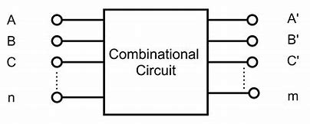
The code is completely based on the concept of combinational circuit.
The output in a combinational circuit depends completely on the present inputs.

Slide 3
TOPIC Verilog code for counting number of 1’s in a given binary sequence

Slide 4
The combinational circuits are mainly used in designing
DECODERS
ENCODERS
MULTIPLEXERS
ADDERS

Slide 5
APPLICATIONS:
DIGITAL MEASURING TECHNICS
DIGITAL PROCESSING
CALCULATORS
DIGITAL COMMUNICATION

